Slide 1
Event density plots, A more dynamical alternative for histogram’s Arjan Wiskerke

Slide 2
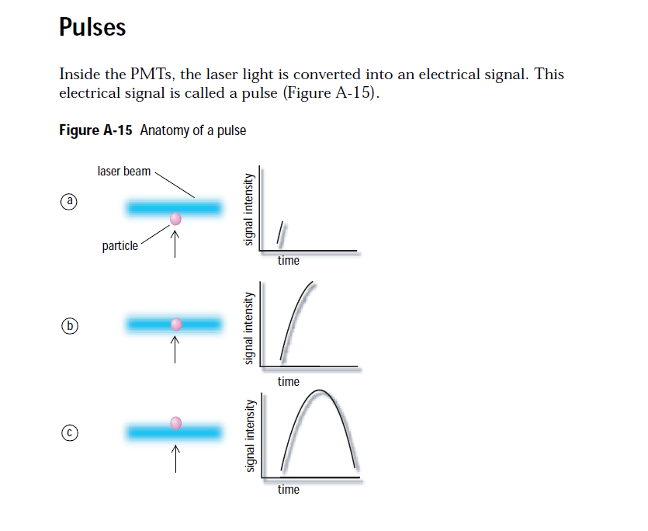
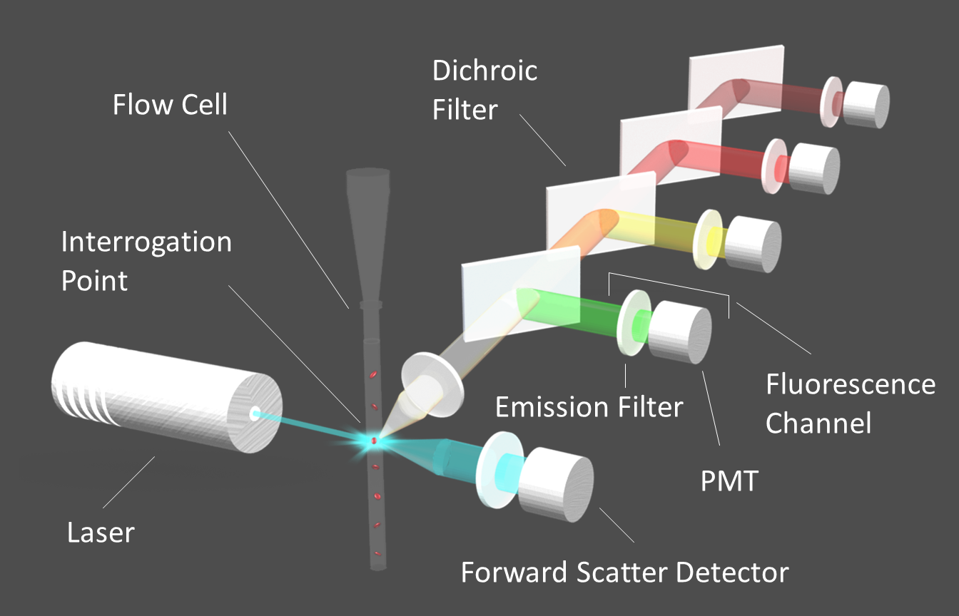
Cytometry
Source BD-FacsCANTO catalog

Slide 3
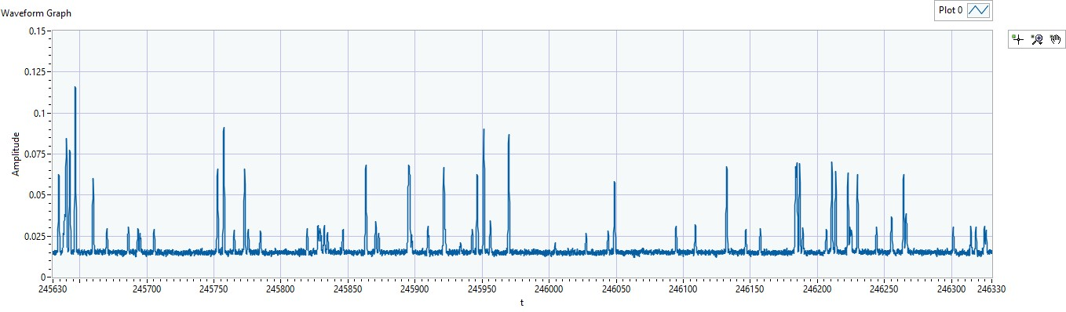
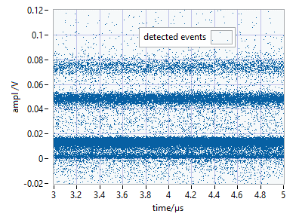
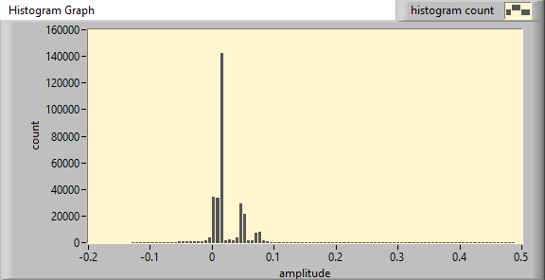
Data collection

Slide 4
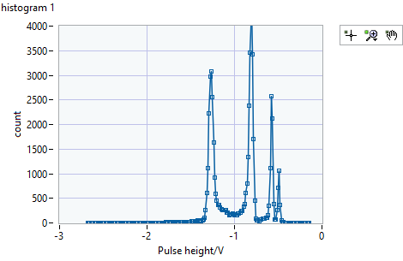
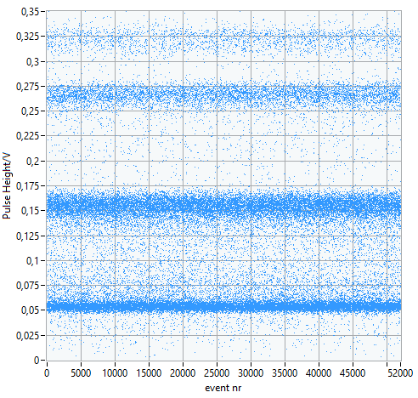
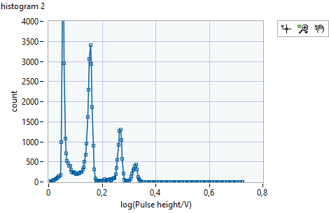
Histograms
Data
linear
data
log

Slide 5
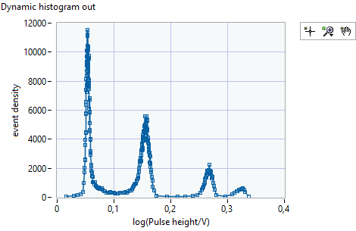
Event density plot

Slide 6
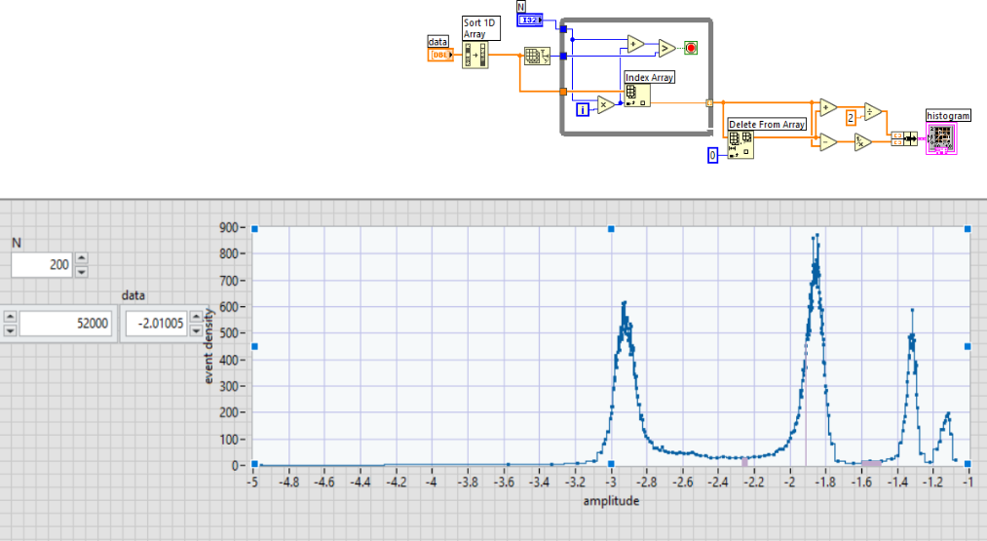
code

Slide 7
Advantages of uneven spaced histograms:
Less parameters are needed
X-axes can be changed without re-binning the data
All bins carry the same information, in subsequent analysis, the data is weighted correctly by default.
Refinements
X values are means of data that falls in the bins
Linear fit to the histogram is useful to avoid zero progression

Slide 8
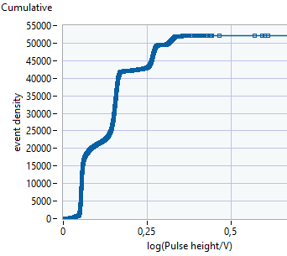
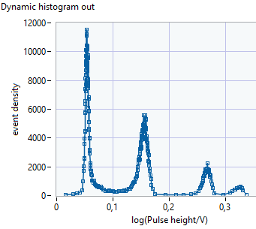
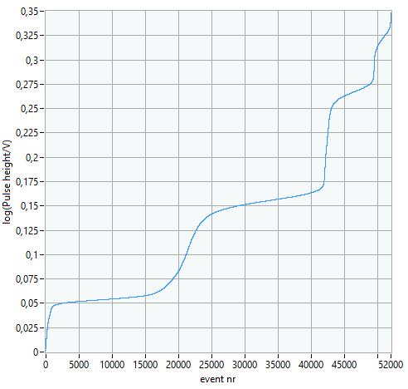
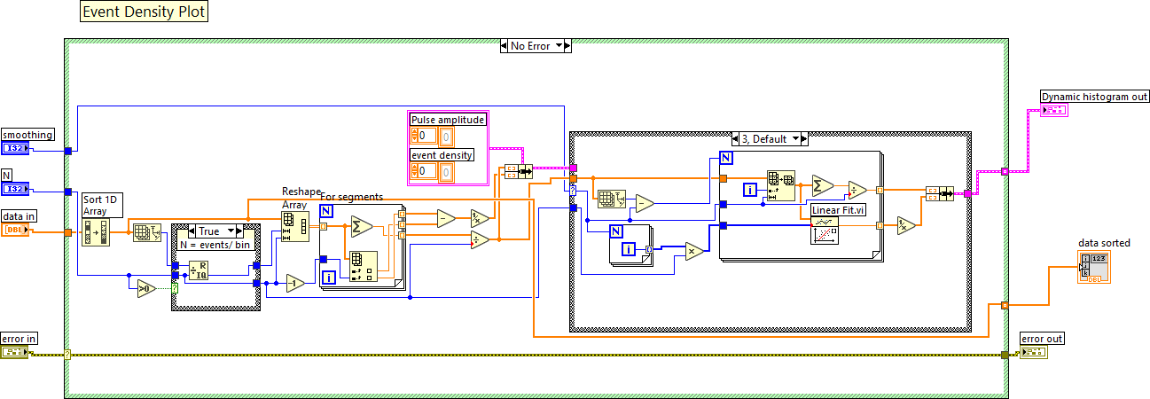
code

